Slide 1

A Textual Analysis of Course Syllabi for Library- and Research-Related Terminology
A Quantitative Approach to Faculty Outreach
Sarah L. Hood
Head Research and
Instruction Librarian
J. Drake Edens Library
Columbia College
Columbia, South Carolina
Notes:
Welcome → Thank you → Who I Am → currently Head Research & Instruction Librarian, since Fall 2015

Slide 2
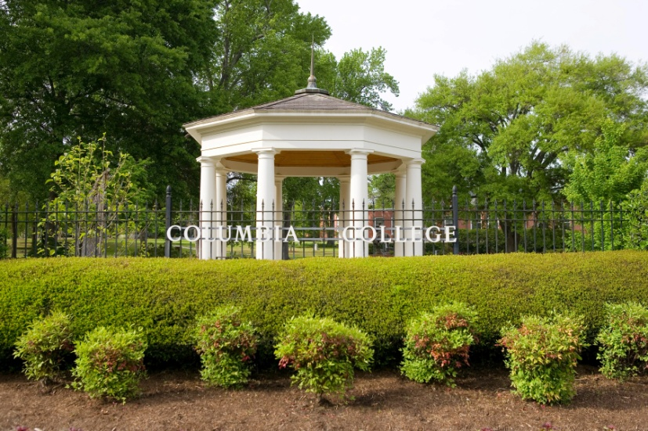

Snapshot of Columbia College
Small, single campus
Private
Liberal Arts
4-year institution
Women-only
  Small handful of co-ed Evening, Graduate and Online programs
Offer 35 undergraduate majors (and 3 Master’s Programs)
FTE
  Spring 2015: 1170
  Fall 2015: 1423
One library serves the college
Notes:
Before I get started talking about my study, let me just….

Slide 3
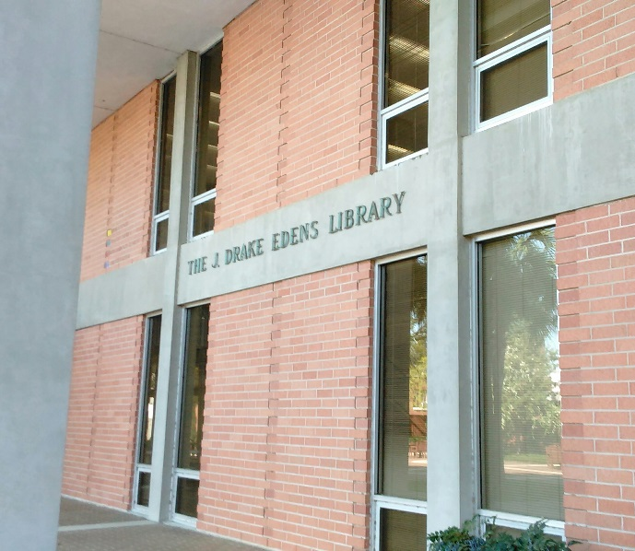
Snapshot of Edens Library
Five (5) full-time, professional librarians
  Director/Periodicals Librarian
  Head Research & Instruction Librarian/Web Manager
  Collection Development/Social Media Librarian
  Circulation/ILL Librarian
  Educational Technology Specialist
Fleet of life-saving student workers!
Notes:
We have a grand total of 4 people who run this library; we are one-person departments, we each wear multiple hats.

Slide 4
Snapshot of our Information Literacy Instruction (IL) Program
(Undergraduate)
Have had a very lively and robust IL program for many years :-)
I teach majority of IL sessions, but our Director and CD
Librarian occasionally teach
IL Instruction = mostly “one-shots”
  Avg. 32 / semester
  Avg. class size = 15 students
  Assignment-based → close collaboration with faculty
No credit-bearing, semester-long IL course at this time :-(
Notes:
Mostly one-shots but we do have one ENG class where we work with them intensely for 4 sessions…

Slide 5
The Study
What
A Textual Analysis of Course Syllabi for Library- and Research-Related Terminology
Analyzed the full text of 425 undergraduate course syllabi for specific key words that would indicate a potential need on the part of the student to engage in the use of one or more library resources

Slide 6




The Study
Why
Marketing Tool
Course
Faculty
Image is from Creative Commons
Notes:
The librarians at my institution, we have an excellent rapport with faculty. But, I wanted a more objective methodology of identifying courses within the curriculum which could benefit from exposure to library services and so this was a way of identifying those folks.

Slide 7
Literature Review
(Brief)
Early Attempts
Rambler, L. K. (1982). Syllabus study: Key to a responsive academic library. Journal of Academic Librarianship, 8(3), 155-59.
Sayles, J. W. (1985). Course information analysis: Foundation for creative library support. Journal of Academic Librarianship, 10(6), 343-45.
Notes:
I’m certainly not the first one to do something like this. Rambler and Sayles are mentioned quite a lot in the literature. Syllabus studies go back to the early-mid 80’s, and I also saw a reference to one done in 1979 although I was not able to locate the primary source itself.

Slide 8
Literature Review
(Brief)
3 Take-Aways
#1
“As a result [of examining course syllabi], librarians can be better prepared and in the longer term can demonstrate to faculty a higher degree of involvement in course instruction.”
- Williams, Cody & Parnell, 2004
Notes:
I think this is so true! This quote really spoke to me because we have several faculty here who truly understand this. They truly “get it.” And I feel very fortunate for that.

Slide 9
Literature Review
(Brief)
3 Take-Aways
#2
“By respecting the exact needs of the instructor, librarians can complement the teaching function rather than play the traditional supplemental role…”
- Sayles, 1985
Notes:
Here’s another one that really spoke to me. Because that’s what we’re about, right? Teaching! So it’s a win-win situation when you can respect that faculty member’s needs, yet also do what we do best, which is teaching information literacy.

Slide 10
Literature Review
(Brief)
3 Take-Aways
#3
“The syllabi can also reveal which faculty one should most likely approach, and follow-up discussions with these selected faculty can then provide further information on library assignments.”
- Dewald, 2003
Notes:
And finally, while this may seem obvious, Dewald notes a very tangible benefit of doing a syllabus study. This is certainly something I’m very excited about following up on.

Slide 11
Research Questions
  How does a faculty member’s perception of the library manifest itself within their course syllabus?
Notes:
The over-arching research question I wanted to explore in this study is….

Slide 12
Research Questions
  How does a faculty member’s perception of the library manifest itself within their course syllabus?
  How can the answer to this question inform Edens Library’s approach to faculty outreach in relation to our Information Literacy Instruction Program?
Notes:
A sub-question would be…

Slide 13
Research Questions
  How does a faculty member’s perception of the library manifest itself within their course syllabus?
  How can the answer to this question inform Edens Library’s approach to faculty outreach in relation to our Information Literacy Instruction Program?
  Based on the presence of library- and research-related terminology within course syllabi, which faculty could potentially benefit from one or more library instruction sessions? (aka, the “one-shot”)

Slide 14
Research Questions
  How does a faculty member’s perception of the library manifest itself within their course syllabus?
  How can the answer to this question inform Edens Library’s approach to faculty outreach in relation to our Information Literacy Instruction Program?
  Based on the presence of library- and research-related terminology within course syllabi, which faculty could potentially benefit from one or more library instruction sessions? (aka, the “one-shot”)
  Of those faculty, with whom have we not yet made contact?

Slide 15
Syllabi Analyzed
Access to Course Syllabi
CC has an intra-campus electronic repository to which faculty are required to upload their syllabi each semester
    No IRB approval was needed but I had to obtain permission from each individual faculty member (116 total)

Slide 16

Syllabi Analyzed
Requesting Faculty Permission
Image is from Creative Commons
Notes:
This is something I’m really proud of. :-) We have a lot of faculty support here at CC!

Slide 17
Parameters of the Study (Set Up)
Course Syllabi Included in the Study:
Spring 2015 and Fall 2015 of all sections of most courses offered in our Undergraduate Programs.
This includes:
    Day College (women-only)
    Evening College (co-ed)
    Online Programs (co-ed)
These include “Independent Study,” “Seminar” and “Senior Project” courses.

Slide 18
Parameters of the Study (Set Up)
Course Syllabi Eliminated from the Study:
Graduate level courses (focus is undergrad)
The following undergraduate courses (these courses would be least likely to require library use)
  Musical Ensembles (MUE), Applied Music (MUA), or Junior/Senior Recitals
  Physical Education – Activities (PEA)
  Labs
  Internships, Apprenticeships, Field Experiences or Study Abroad in any discipline

Slide 19
Syllabi Analyzed
DISCIPLINE
Notes:
I didn’t want to limit to any particular area or discipline, so I looked at them all. Since we’re a small campus, I knew this would be feasible.

Slide 20
Syllabi Analyzed
COURSE LEVEL

Slide 21
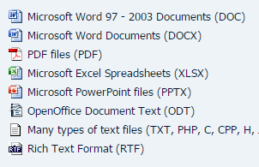
Methodology
Generating Results
SeekFast™ WHAT IS IT?
seekfast.org
  “…quickly and easily search text in [up to 10,000] files on your computer. SeekFast can search in all commonly used types of documents.”

Slide 22
Methodology
Generating Results
SeekFast™ COST
seekfast.org
  Version 2.3
  $28 one-user license
  Can purchase up to 50 licenses for $450

Slide 23
Methodology
Generating Results
SeekFast™ HOW IT WORKS
seekfast.org
  *Similar* to a Ctrl+F command for multiple files
  Can search Word and PDF docs simultaneously

Slide 24
Methodology
Generating Results
SeekFast™ NEGATIVES
seekfast.org
  Seems to be no tech support after purchase :-(
  “Note that the file may contain unlimited number of sentences compliant with your search, but only the most relevant ones are displayed.”
    To get a truly accurate count, I still had to open each file and do Ctrl+F
Image is from Creative Commons
Notes:
SF wasn’t as efficient and accurate as I would have liked, but neither were other Text Finder software products I tried. I felt it was helpful enough to give me a good idea of which syllabi contained the words I was looking for.

Slide 25
Methodology
Word-Count and Occurrence
Words Searched
Library Scholarly
Librarian Peer-reviewed
Literature review Refereed
(and other variations of) Journal
Database

Slide 26
Methodology
Word-Count and Occurrence
Circumstances in which I did not count the occurrence of a word:
Scholarly: When used in a general sense
  i.e. “student must demonstrate scholarly writing,” “students are expected to engage in scholarly discussion during class”
Journal: When used as a verb
  i.e. used in the context of “keeping a journal” or diary
Database: When not referring to a library database
  i.e. databases used in Math classes

Slide 27
Methodology
Word-Count and Occurrence
Special Note About The Word “Library”:
When it simply referred to the LOCATION of something (i.e. a faculty member’s office or classroom, IT, Media Center, or the Academic Skills Center) I counted that occurrence, but I classified it as a Non-Related (N-REL) occurrence.
Pertinent (REL) occurrences generally fell into 3 categories, which I recorded.
      Course Reserves
      Citation help
      Research-specific

Slide 28

Wanted to search these words also…
Paper
Essay
Research
But…
Image is from Creative Commons
Notes:
There were some other words that I initially wanted to look for as well, but proved to be overwhelming; a lot of results were irrelevant.

Slide 29
Methodology
Recording Results
MS Excel
  Simple, relatively easy to use
  Part of MS Office (No need to purchase additional software)

Slide 30
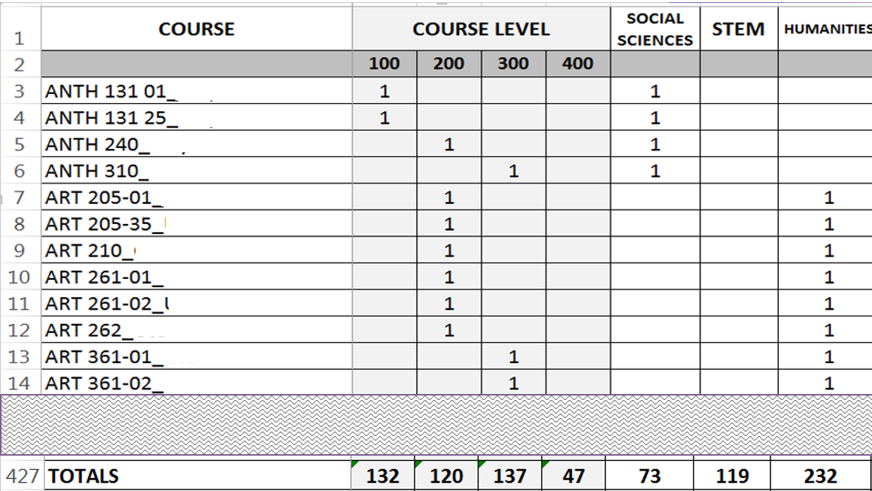

Slide 31
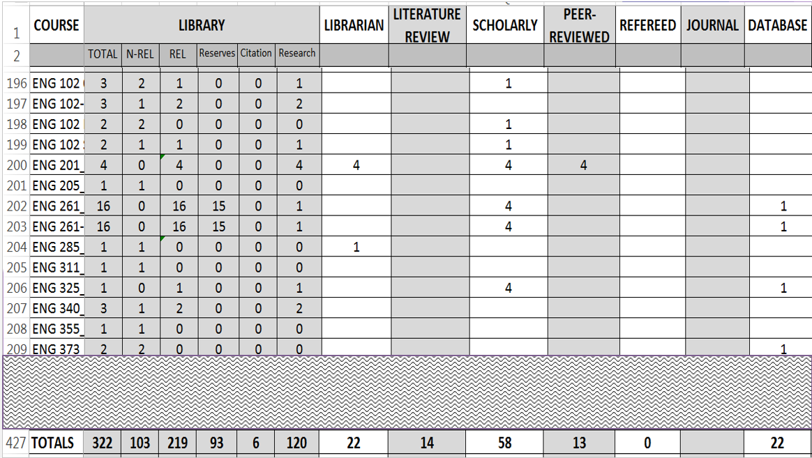

Slide 32
Results
Out of 425 Syllabi…
209 (49%) made NO reference to any of the words on the list
216 (51%) made reference to at least one of the words on the list
425 – 209 = 216
[Filter 1]

Slide 33
Results
  Of those 216 Syllabi…
  46 (21%) make only a Non-Related (N-REL) reference to the library, and no reference to any of the other words I searched
  170 (79%) either make a Related (REL) reference to the library OR to one or more of the other words I searched
  216 – 46 = 170
  [Filter 2]

Slide 34
Word References
Out of those 170 Syllabi…
122 | or 72 % | make (REL) reference to the word… | LIBRARY
61 | or 36 % | make reference to the word… | JOURNAL
33 | or 19 % | make reference to the word… | SCHOLARLY
19 | or 11 % | make reference to the word… | DATABASE
14 | or 8 % | make reference to the word… | LIBRARIAN
9 | or 5 % | make reference to the word… | PEER-REVIEWED
7 | or 4 % | make reference to the word… | LITERATURE REVIEW

Slide 35
Results
  Of those 170 Syllabi…
  28 (16%) had received library instruction
  (170 – 28 = 142)
  [Filter 3]

Slide 36
Results
  Of those 142 Syllabi…
53 (37 percent) make reference to the library in the context of Course Reserves (They may have made references to other words on the list also)
  Of particular note: two ENG 261 course syllabi each made 15 such references. This information could potentially be very helpful for Collection Development
6 (4 percent) make reference to the library in the context of Citation Help (They may have made references to other words on the list also)

Slide 37
Results
  Of those 142 Syllabi…
35 (25 percent) ONLY made reference to the library either in the context of Course Reserves or Citation Help. Additionally, they did NOT reference any other word I searched.
142 – 35 = 107
[Filter 4]

Slide 38
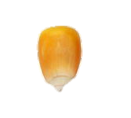
107
Course syllabi either make reference to the library in the context of Research Activities and/or reference one or more of the other words I searched.
Image is from Creative Commons
Notes:
OK, so *THIS* is the Golden Kernel of Knowledge, if you will, in terms of who I wanted to reach out to.

Slide 39
Discipline
Notes:
So, with these 107 course syllabi, I wanted to see the same sort of break-down in the disciplines and how it compares with the institution overall, which I’ll show in just a sec.

Slide 40
Course Level
Notes:
Same with course level…..

Slide 41
CONCLUSIONS
&
DISCUSSION

Slide 42
Discipline
19%
34%
16%
26.5%
54.5%
50%
Notes:
OK, so when we compare the Discipline break-down side by side, you’ll notice that there’s a much higher percentage in the Social Sciences within the remaining 107 syllabi. This would seem to suggest we definitely need to reach out more to the Social Sciences.

Slide 43
Course Level
9.5%
10.5%
25%
31%
36.5%
31.5%
29%
27%
Notes:
And with the course level comparison, this would seem to suggest that we’re doing fairly well reaching the 100-level classes, but that we need to reach out a little more to the 300-level courses and perhaps a tad bit more to the 200-level courses as well.

Slide 44
107 out of 425 course syllabi
(that’s 25 percent!!)
indicated a clear need for outreach from IL librarians
Notes:
That really took me by surprise. It really made me realize that while word of mouth can certainly be an effective tool for getting faculty into the library, this study let me know that we do indeed have more work that needs to be done on this front. And when I actually looked at these 107 course syllabi and who taught these courses, I can tell you, anecdotally, that some – not all – but some of these faculty will likely pose some…interesting challenges :-) in terms of outreach.

Slide 45
Faculty = 51
Course
Faculty
Image is from Creative Commons
Notes:
So in terms of faculty members, that translates to 51 that we need to reach out to.

Slide 46
Notes:
This really puzzled me at first because when I looked at *who* these faculty actually were, I realized that basically half of them were “old hat”. In other words, roughly half of them are already bringing at least *some* of their classes in. So it raised a really question: Why are these folks not bringing their *other* classes in? Could it be that they feel or assume that their students in prior classes (that *have* come to the library) don’t need more IL instruction? So that’s a question that may need some answering.

Slide 47
What am I working on?
Making individual contact with ID-ed faculty
  PSY 349 – F2F IL session
  2 or 3 video tutorials for Online Program

Slide 48
Questions??
Notes:
OK, I’ve got some discussion questions for us, but before we get started on that, does anyone have any specific questions or comments for me?

Slide 49
Discussion Question 1
Do you have faculty who have traditionally been resistant to bringing their classes in for an instruction session? Were you or your colleagues able to overcome that? Does anyone have any success stories they’d like to share?

Slide 50
Discussion Question 2
If you could tell faculty anything you wanted to about the construction of their course syllabi, what would it be?

Slide 51
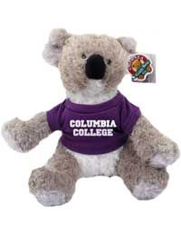
CiCi and I say…
Thank you!

Slide 52
Links of Interest
About → Information Literacy Instruction Program at Edens Library, Columbia College
http://libguides.columbiasc.edu/library/informationliteracy
SeekFast™ Software
http://seekfast.org/

Slide 53
References
Bean, R., & Klekowski, L. M. (1993). Course syllabi. Extracting their hidden potential. Course Syllabi. Extracting Their Hidden Potential, 1-9.
Boss, K., & Drabinski, E. (2014). Evidence-based instruction integration: a syllabus analysis project. Reference Services Review, 42(2), 263-276. doi:10.1108/RSR-07-2013-0038
Dewald, N. H. (2003). Anticipating library use by business students: the uses of a syllabus study. Research Strategies, 19(1), 33-45. doi:10.1016/j.resstr.2003.09.003
Lauer, J. D., Merz, L. H., & Craig, S. L. (1989). What syllabi reveal about library use: A comparative look at two private academic institutions. Research Strategies, 7167-174.
Rambler, L. K. (1982). Syllabus study: Key to a responsive academic library. Journal of Academic Librarianship, 8(3), 155-59.
Sayles, J. W. (1985). Course information analysis: Foundation for creative library support. Journal of Academic Librarianship, 10(6), 343-45.
Smith, C., Doversberger, L., Jones, S., Ladwig, P., Parker, J., & Pietraszewski, B. (2012). Using course syllabi to uncover opportunities for curriculum-integrated instruction. Reference & User Services Quarterly, 51(3), 263-271.
Williams, L. M., Cody, S. A., & Parnell, J. (2004). Prospecting for new collaborations: Mining syllabi for library service opportunities. Journal of Academic Librarianship, 30(4), 270-275.

Slide 54
Social Sciences
Anthropology
Economy
Geography
Gender/Women’s Studies
History
Political Science
Psychology
Sociology
Social Work
STEM
Biology
Business
Chemistry
Computer & Information Systems
Criminal Justice*
Emergency Management
Math
Public Health*
Speech Language Pathology
Humanities
Communication
Education/Special Education
English & Literature/Writing
Foreign Languages
Liberal Arts
Leadership
Performing Arts
Philosophy
Religion

